Slide 1
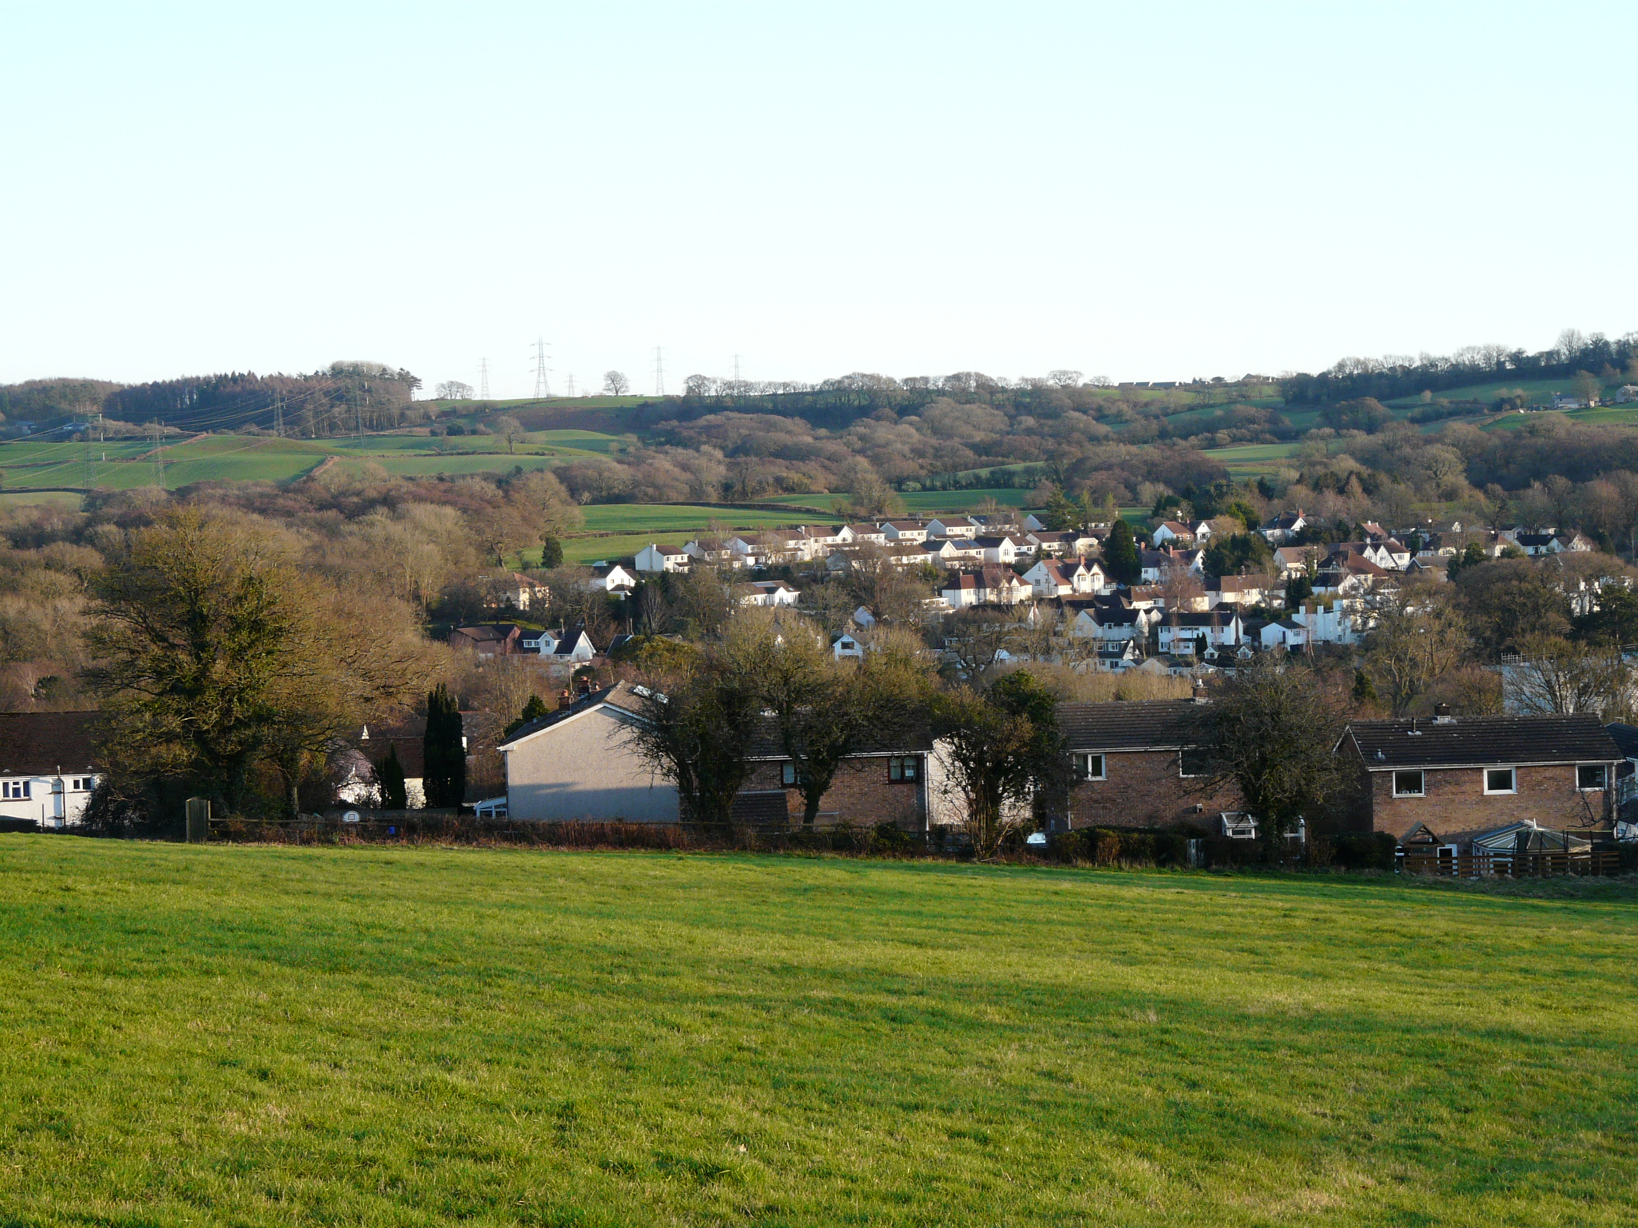
Do you want to: - downsize - find your first home - get a bigger home - move to another area
Housing Needs Survey
Join us for a chat in the Village Hall, Peterston Super Ely on 4th June 2025 between 11am and 2pm
Light refreshments provided

